Slide 1
Local Linear Regression in Reinforcement Learning
Reinforcement Learning Workshop
Thijs Ramakers
December 1, 2009
Delft Center for Systems and Control
Notes:
Hello everybody, thanks for being present here.
Introduction to by Msc thesis, titled ‘speeding up reinforcement learning using prioritized sweeping and model-building techniques’

Slide 2
Overview
Solving a reinforcement learning problem
Model-learning solution approach
Local Linear Regression
  Tuning parameters
  Model accuracy
Two-link manipulator results
Summary / Future work
December 1, 2009

Slide 3
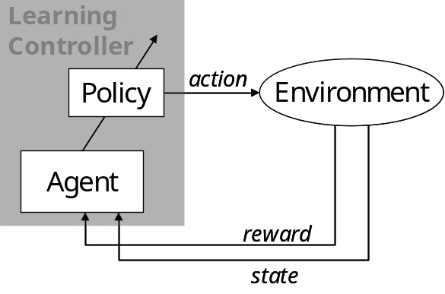
Reinforcement Learning
 |  |  |  |  |  | G
 |  |  | S
At each time step:
Process is in a state
Controller takes action
according to its policy
Process makes transition into next state
Controller receives reward
2D grid example:
56 states
4 actions
Reward:
+1, goal state
0, elsewhere
December 1, 2009
Notes:
RL is derived from the idea that past experiences can be used for future behavior. RL is trial and error.
System is in a state that fully describes the system. An action is tried, a scalar reward is the received feedback. Agent’s goal: maximize the reward that is received during an episode. The action in every state is the policy. This process is called a Markov Decision Process.
State
Action
Policy
State transition function (probabilistic / deterministic)
Reward function

Slide 4
Solving a Reinforcement Learning problem
Solution: Find value function for the entire state-space
Method: By using a model or by interaction with real setup
Problem: State-space is usually very large, due to:
  Many discrete states
  Many dimensions
  Continuous state-variables
December 1, 2009
Notes:
RL problems can be solved for relatively simple problems. For larger problems, learning becomes slow due to:
Continuous states. VF has to be approximated and a state is never encountered twice.
High number of dimensions: leads to a very high number of states. Makes it very difficult to determine VF for the total state-space
Slow propagation of information: Once the goal is found, this information propagates through the state-space very slowly.
This last problem is dealt with in the work.

Slide 5

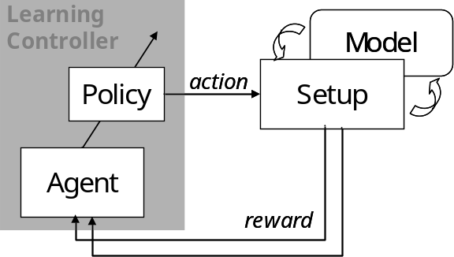
Model-learning approach
No model available, but interaction with setup only is not sufficient
Build a state-transition model:
Use model to re-live experiences (‘dreaming’)
More experiences to fill state-space
Use model and setup simultaneously
state
December 1, 2009
Notes:
Several solution approaches exist. We will focus on the model-learning approach.
Model-learning:
No a priori model is available, but model is learned during the learning process.
Solution method: Switching between on-line (model-free) and off-line (model-based) learning.
The model is used to generate more experiences to learn from. The same update rule is used for the model and the setup. Fill total sample interval with model-based experiences.

Slide 6
Model-building demands
Demands:
  Dealing with continuous state variables
  Model non-linear system
  Estimate model from few observations
  Good accuracy
  Applicable to high dimensional problems
  Efficient in CPU & memory usage
December 1, 2009
Notes:
Demands for the model-building technique:
Continuous states
Learning from few observations
Good accuracy (only in parts of state space?)
High dimensional problems
Efficient in CPU/memory usage (has to be applied in real time)

Slide 7
Memory-based learning
Store all past experiences in memory
Advantages:
+ Fast learning
+ New experiences are used immediately
    + Local approximation of function
    + No fixed (global) structure needed
Disadvantages:
    - Storing large dataset
    - Noise sensitive
December 1, 2009
Notes:
Focus on a type of model-building technique called memory-based. A large number of experiences is simply stored in memory and used when needed.
Advantages:
Function can be approximated locally
No global structure is needed
Disadvantages:
Large dataset has to be stored.
Noise sensitive

Slide 8

Local Linear Regression (LLR)
        Store observed experiences
        (state, action → next state)
        Search k nearest samples
        (according to some distance measure)
        Estimate linear model:
        (using Least Squares techniques)
        Results in a piece-wise linear model
y
ŷ_{q}
(k = 5)
X_{q}
x
December 1, 2009
Notes:
The K-Nearest Neighbor method also relies on storing past input-output pairs.
The estimated output is simply obtained by averaging the output of the K nearest stored inputs. Calculating the distances of all samples is the most computationally heavy.
K can be seen as a measure for the amount of generelization.
Local Linear Regression can be seen as an extension to KNN. Instead of averaging the outputs, a linear model is fitted to the K data samples. This leads to a piece-wise linear model.
A simple Least Squares approach can be used. Weighted Least Squares is also possible to give a higher weight to close samples.

Slide 9
LLR parameters
Researched:
Distance measure
Number of neighbors
Other possibilities:
weighted distance measure
weighted regression
December 1, 2009

Slide 10
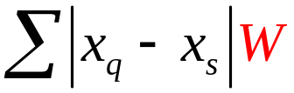
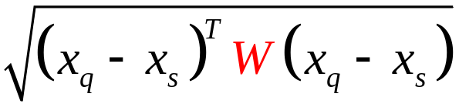

Distance measure
1-norm: (Manhatten distance)
2-norm: (Euclidean distance)
∞-norm:
Possibility to use weights (not researched)
  Best choice? No definite answer…
December 1, 2009

Slide 11
Number of neighbors
Optimal value depends (locally) on:
  Number of samples in memory
  Sample density
  Linearity of target function
  Noise
Optimal value can vary throughout the state-space
→ determine local optimum?
December 1, 2009

Slide 12
Optimal number of neighbors
Influence of k on estimation error in three different situations
Linear function with noise
Nonlinear function without noise
Nonlinear function with noise
y
y
y
ŷ
ŷ
ŷ
x_{q}
x
x_{q}
x
x_{q}
x
error
error
error
k = ∞
k = 1
k = ?
k
k
k
December 1, 2009

Slide 13
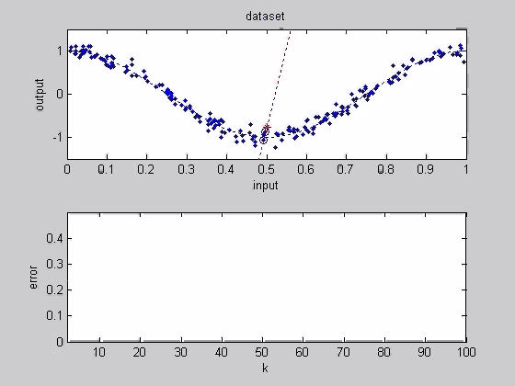
1D example
Nonlinear function (cos(2πx))
Added white noise (σ²=0.01)
200 samples
Query point x_{q} = 0.5
k = 1, 2, …, 100
Optimal value: k > 3, k < 15
Open question: How can we determine the optimal value based on the dataset?
December 1, 2009

Slide 14
Measurement for Estimation accuracy
Measure based on data in memory
(output is not always available, or can be disturbed by noise)
Usage:
Identify faulty data (spikes/disturbances)
Confidence in estimated output
Determine optimal number of neighbors
Use accuracy as weights in RL algorithm?
December 1, 2009

Slide 15
Measurement for Estimation accuracy
Possible options:
Based on Least Squares residual
Based on distance measure
Other possibilities?
residual
x_{q}
distance
Ideal situation…
Estimation error
Accuracy measurement
December 1, 2009

Slide 16
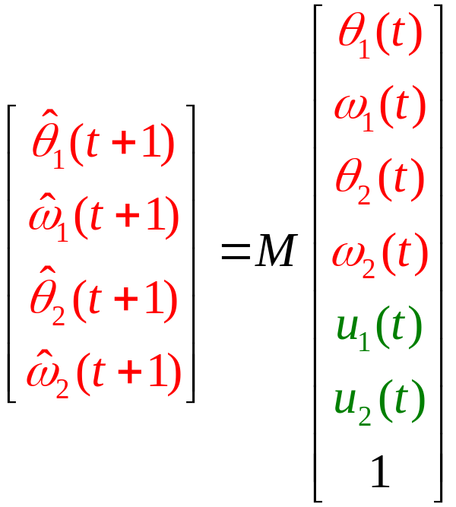




Experiments with two-link manipulator simulation
6 inputs (4 state variables, 2 control voltages)
4 outputs (4 state variables)
Estimated model is affine, instead of truly linear
December 1, 2009

Slide 17
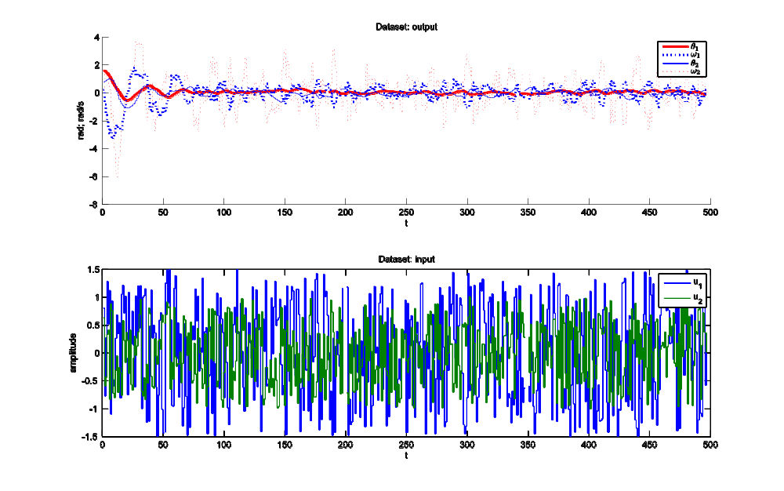
Experiments with two-link manipulator simulation
Parameters:
T = 100 s
T_{s} = 0.2 s
k = 30
Random input
December 1, 2009

Slide 18
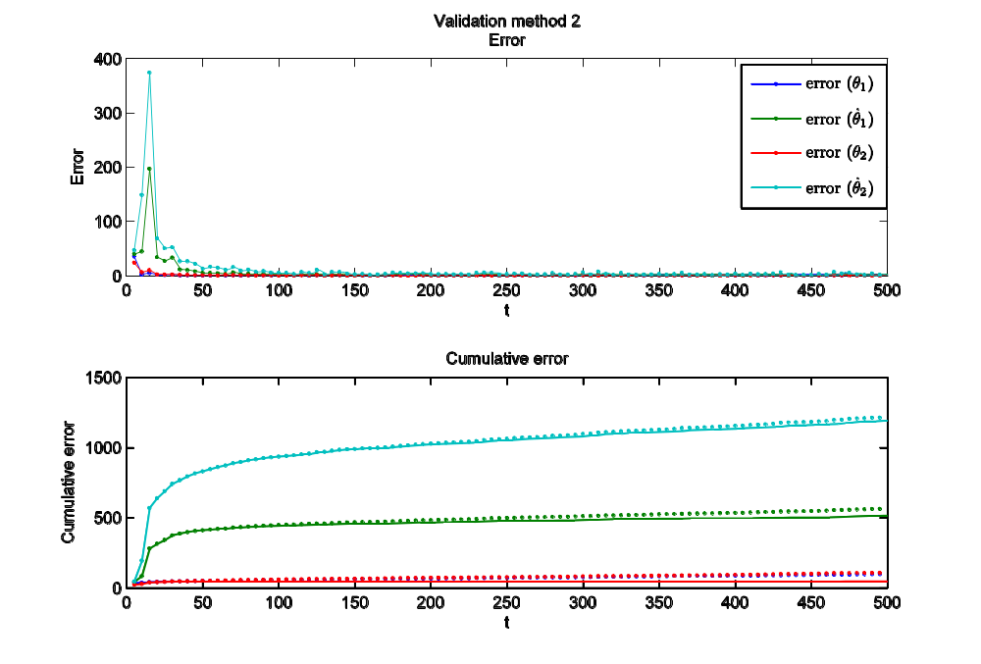
Results of two-link manipulator simulation
  Use LLR to estimate a random state-transition or a short trajectory
  Estimation error improves the first 100 samples
December 1, 2009

Slide 19
Future work
  Finalize LLR scripts
  Use LLR to model real system (robot Leo)
  Implement LLR in Reinforcement Learning
December 1, 2009
Notes:
I would like to conclude with an overview of the total project.
I will research two important aspects of PS:
Different techniques for building a state-transition model
Influence of PS on learning speed
Application on increasingly complex setups
Finally: Application of PS on robot Leo (Leo learns to walk?)

Slide 20
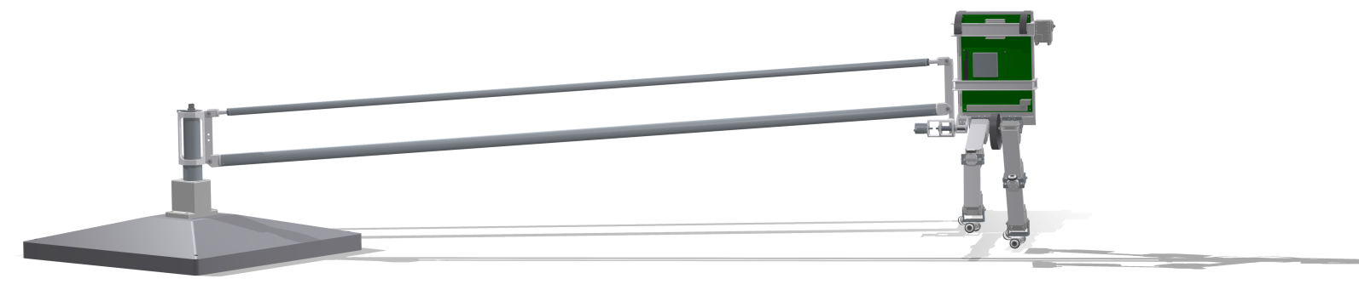
Questions, Comments, Suggestions?
December 1, 2009
Notes:
Are there any questions? Or suggestions?

